Slide 1
Introduction to Puppet Programming

Slide 2
Key terms in Puppet Programming
Manifests
Classes
Resources
Puppet Modules

Slide 3
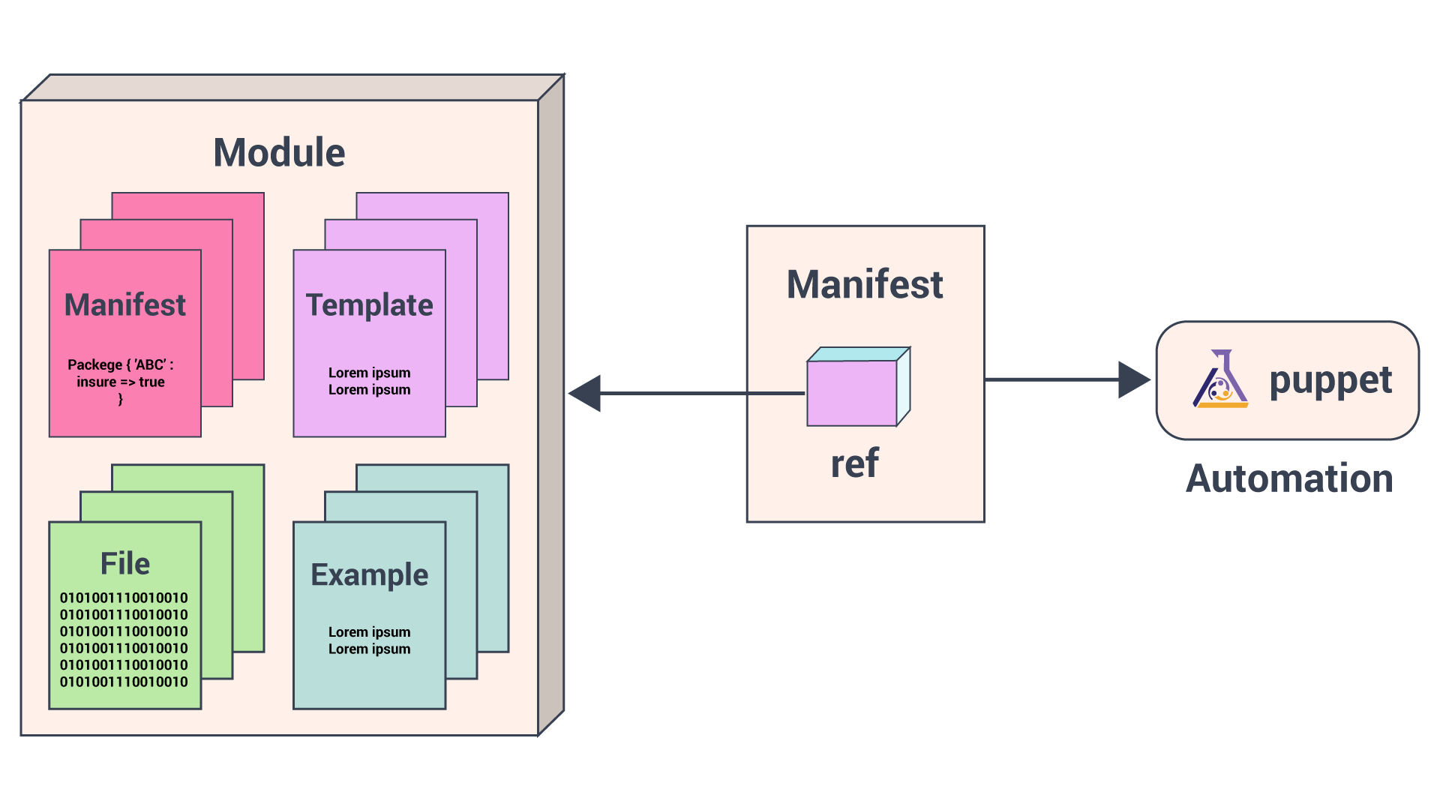
Puppet Modules

Slide 4
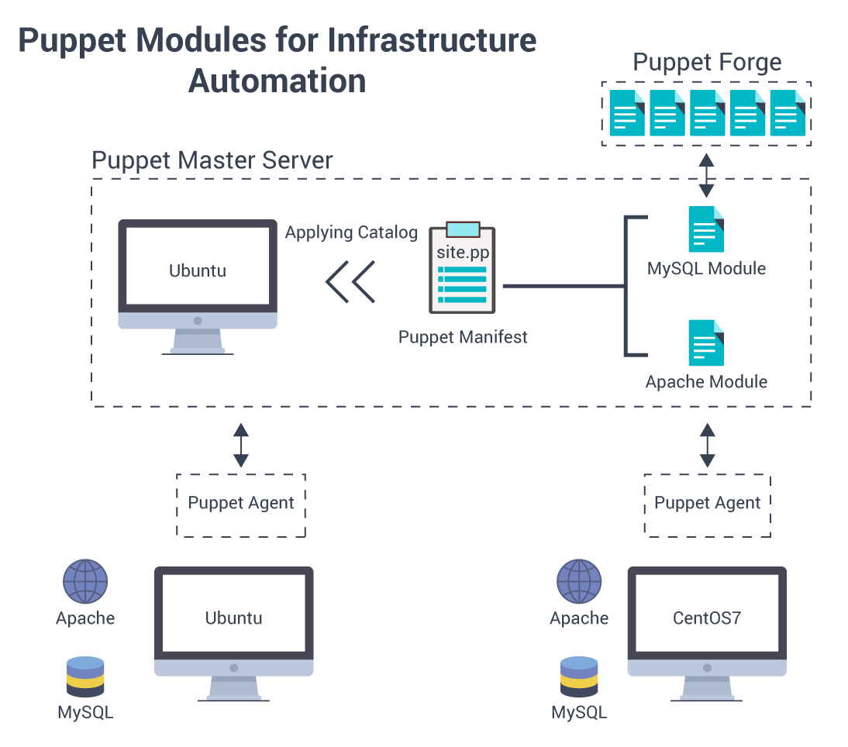
Notes:
https://www.edureka.co/blog/puppet-modules-automation/

Slide 5
Hiera

Slide 6
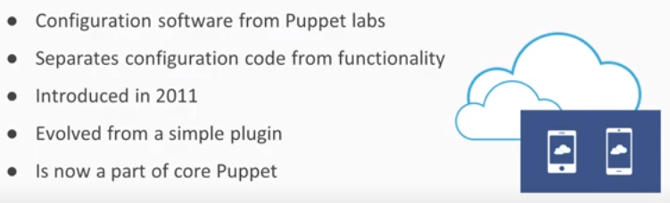
What is Hiera

Slide 7
What is Hiera
Built in key value configuration data lookup store.
Powerful way to store (class parameter) data outside of your pp files
Stores this data in a efficient hierarchial structure so to minimize code duplication.
Useful when
You want to declare a class that requires a lot of class parameters

Slide 8
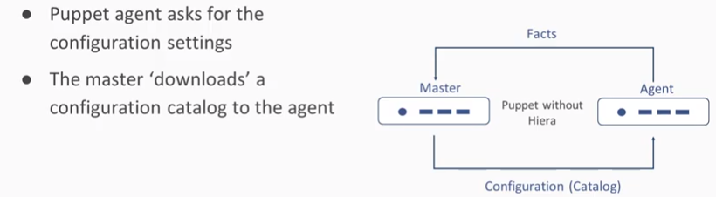
Puppet without Hiera

Slide 9
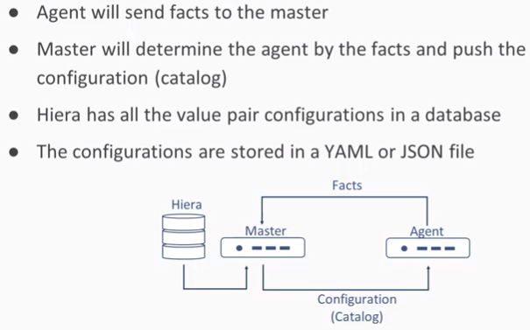
Puppet with Hiera

Slide 10
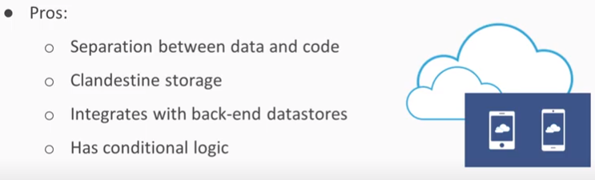
Pros

Slide 11
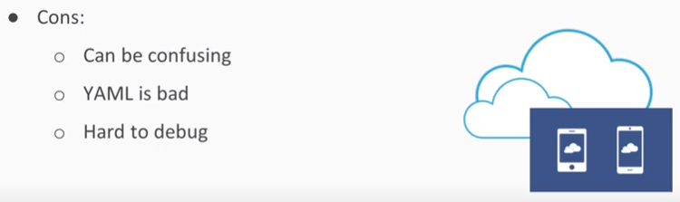
Cons

Slide 12
Hiera configuration file
Hiera has it’s own config file, called hiera.yaml.
Resides in “/etc/puppetlabs/code” directory
It is yaml file named “hiera.yml”

Slide 13
hiera.yaml
Before you can start using hiera, you first need to tell hiera (via the hiera.yaml file):
What types of files to search through (i.e. yaml files, or json files, or both)
We specify this under the “:backend” setting.
What are the names of these data files
We specify this under the :hierarchy setting.
In what order to look look through these files
We specify this under the “:hierarchy” setting
Also in the “:backend” setting which dictates which file type should be scanned first
In which directory all the data files are located
We specify this under the “:datadir” setting.

Slide 14
hiera.yaml
All this information is provided to Hiera via the hiera.yaml file:
# rpm -qc hiera /etc/hiera.yaml
# cat /etc/hiera.yaml
---
:backends:
- yaml
- json
:hierarchy:
- fileA
- fileB
- global
:yaml:
:datadir: /etc/hieradata/yaml
:json:
:datadir: /etc/hieradata/json

Slide 15
Create file
vim /etc/hieradata/yaml/global.yaml
---
dad: homer
hiera dad
homer

Slide 16
A sample YAML based configuration
---
ldap_servers:
- 10.132.17.196
- 10.132.17.195
users:
joe:
home: '/home/joe'
jenkins:
password: 'mysecret'

Slide 17
Accessing Hiera Data using CLI
hiera ldaps_ervers
If you have used interpolation in the “:datadir” configuration, You should add the parameters as shown below.
hiera ldap_servers ::environment=production

Slide 18
Accessing Hiera Data From Modules
Use the following syntax in your module to access the data directly.
$ldapservers = hiera("ldap_servers")
$ldapserver is just a puppet variable.
You can substitute hiera without assigning it to a variable.
Can set a default value
$ldapservers = hiera_array("ldap_servers","10.32.34.45")

Slide 19
Thanks

